Slide 1
Women's E-Commerce Clothing Reviews
Task: Predict the reviewer’s birth decade (90’s, 80’s, 00’s, etc.) using only text features

Slide 2
Data Description
Clothing ID (Categorical Integer)
Age (Positive Integer)
Title (String)
Review Text (String)
Rating (Positive ordinal integer )
Recommended Indicator (Binary)
Positive Feedback Count (Positive Integer)
Division Name (Categorical):
Department Name (Categorical):
Class Name (Categorical)

Slide 3
Data preparation
Visualizations w.r.t Decade
Filtered out non-textual features
Filtered rows with missing “Age” or “Review Text”
Calculated the “Decade” of Birth using Age. (Assumption: Data is from year 2020)
Collected word and character counts of “Review Text”
Cleaned and lemmatized the “Review Text” for any future feature extraction
The following viz were sought to “view” potential discriminative features.
The main idea was to identify trends that could be modelled as features for the task.

Slide 4
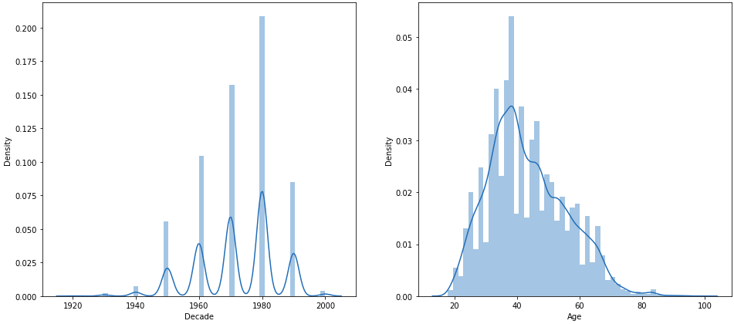
Density of available samples against Decades
Notes:
Gave idea for weighted loss due to class imbalance

Slide 5
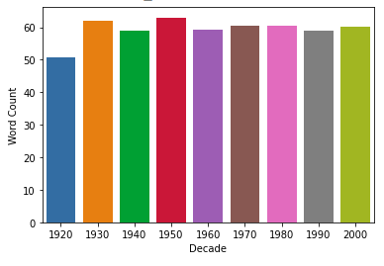
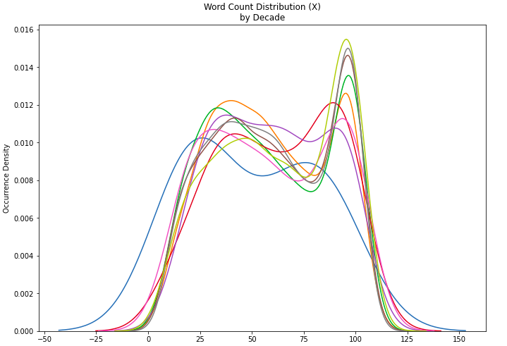
Average word count against Decades

Slide 6
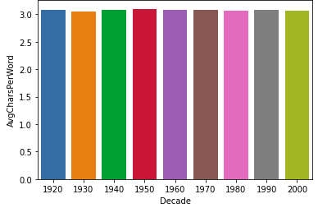
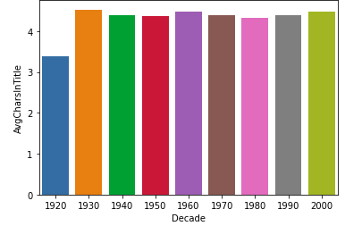
Average character count against Decades

Slide 7
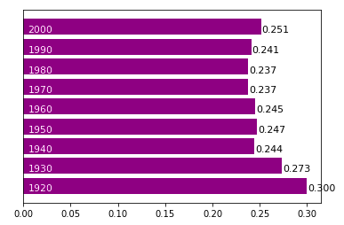
Decades against Sentiment Polarity

Slide 8
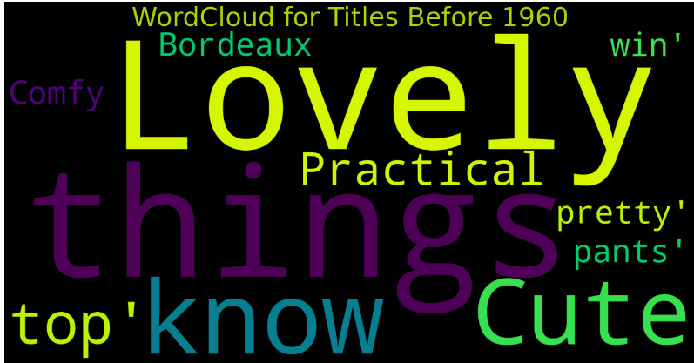
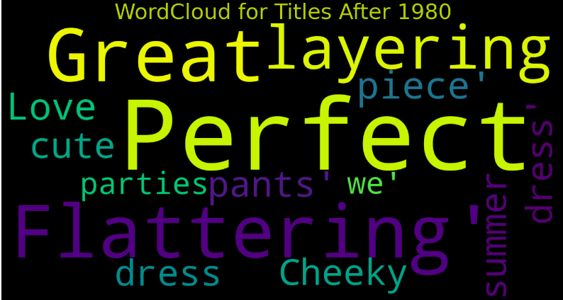
Word Cloud before 1960 and After 1980

Slide 9
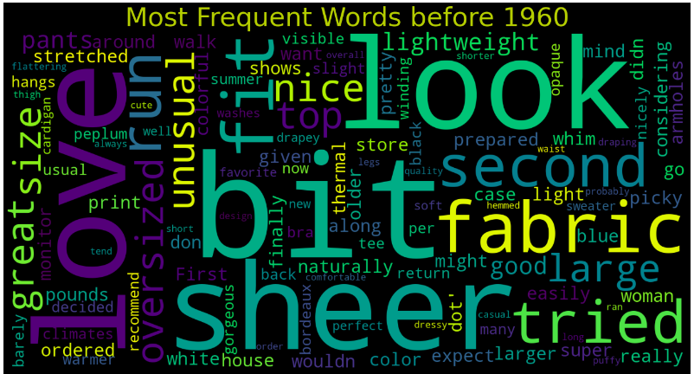
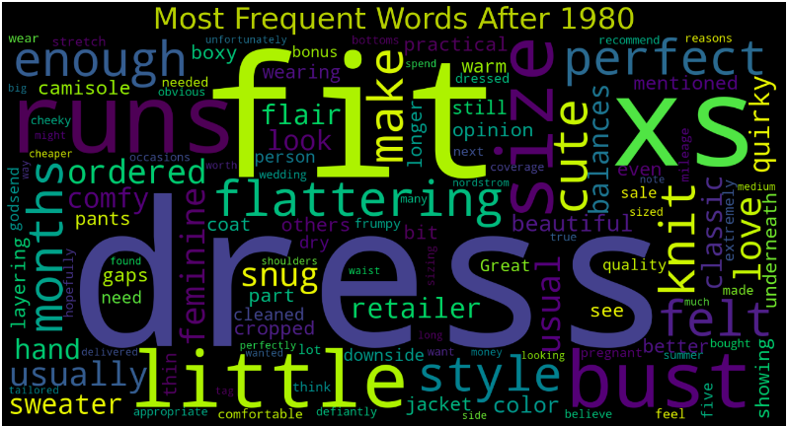
Word Cloud before 1960 and After 1980

Slide 10
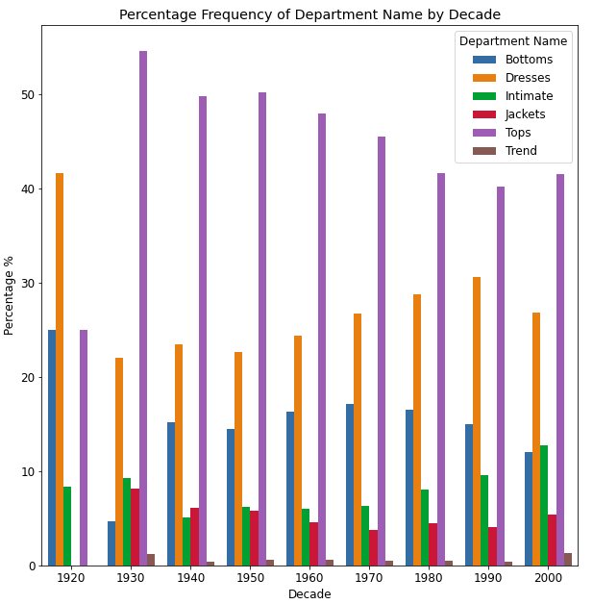
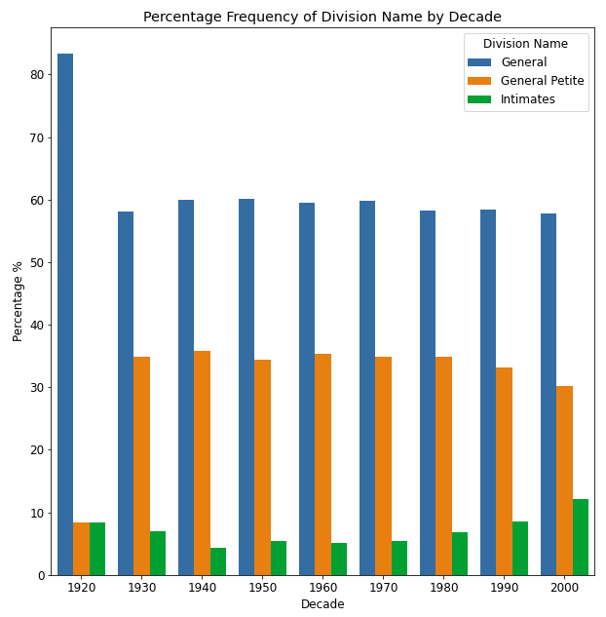

Slide 11
Naive classification
Got the features for “Review Text” by Count Vectorizer using uni-grams and bi-grams
Classified these features using Gaussian Naive Bayes
Results:
Variation | Mean Accuracy
Only review text | 0.161
Review text + categorical column data | 0.168
Only categorical column data | 0.334

Slide 12
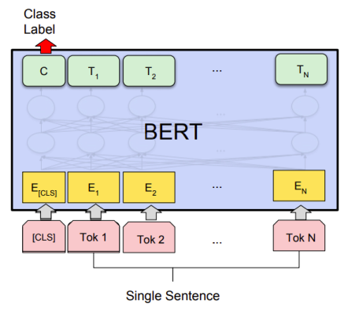
Bert For Sequence Classification
Train (Split: 0.70, 15848)
Val (Split:0.15 , 3396)
Test (Split: 0.15 , 3397)
Obtained contextualized embeddings for the concatenated textual features.
Passed the pooled output of the embeddings into Linear Layers(2) to obtain logits for each class (Decade)
The total loss is calculated using Cross Entropy
Notes:
Randomly sampled out 0.7 for train
0.15 for validation
0.15 for test
NNLoss: - Sigma((Li)log(Si)) Li is the class label, Si is the probability given to it.
CrossEntropy: - log((e^Si)/sigma(e^Si))

Slide 13
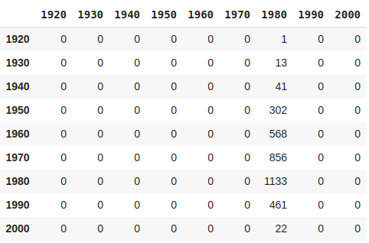
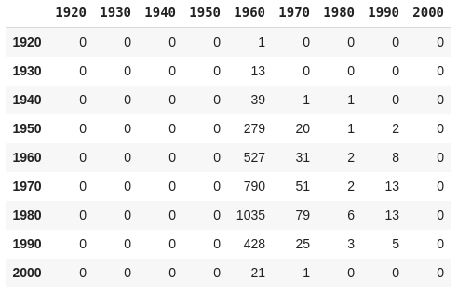
Original Predictions without Weighted Loss
Predictions with Weighted Loss
F1 Score: 0.3335
F1 Score: 0.173
Notes:
[195.65432099 29.34814815 9.07674685 1.25241031 0.66473722 0.44099396 0.3333123 0.81901809 16.93162393]

Slide 14
Further Improvements
Experimentation with language based features such as pos tags, polarity, and categorical data concatenated with the word embeddings.
Bert + KimCNN
Hyper-parameter tuning

Slide 15
Scaling to billions of data
Data: Use “Feature Stores” that directly access, select and transform incoming raw data into required features by using Apache Spark.
Train: Separate out tasks that requires GPU (deep-learning models) and use CPU for the rest.
Eval: Setup automated pipelines for model variations and to log the variation vs accuracy in order to reuse/reproduce.
Monitor: Log predictions vs outcomes to continuously monitor accuracy and evaluate model degradation.
Notes:
Sagemaker: Pipeline to train and deploy
Delta Lake for data store
Apache spark: Data Processing.
User feedback? And prototyping

Slide 16
References
Statistical Analysis on E-Commerce Reviews, with Sentiment Classification using Bidirectional Recurrent Neural Network (RNN)
https://arxiv.org/abs/1805.03687
Text Classification Algorithms: A Survey
https://www.mdpi.com/2078-2489/10/4/150/htm
Deep Learning Based Text Classification: A Comprehensive Review: https://arxiv.org/pdf/2004.03705.pdf
Scaling Machine Learning at Uber with Michelangelo
https://eng.uber.com/scaling-michelangelo/

Slide 17
Thank you!

